Slide 1
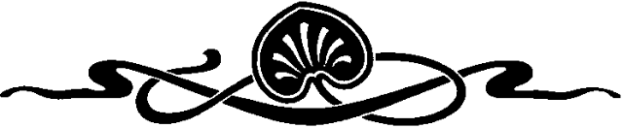
COMPUTER GRAPHICS
Hochiminh city University of Technology
Faculty of Computer Science and Engineering
CHAPTER 6:
Lighting and Shading

Slide 2
OUTLINE
Introduction
Shading model
Flat shading & smooth shading
Using Light Sources in OpenGL
Working with material in OpenGL
Computation of Vectors

Slide 3
Introduction
Calculating the pixel’s color
Introduce the types of light-material Interactions
Build a simple reflection model---the Phong model--- that can be used with real time graphics hardware
Don’t try to simulate all of the physical principles having to do with the scattering and reflection of light
Models have been invented that use approximations and still do a good job producing various levels of realism

Slide 4
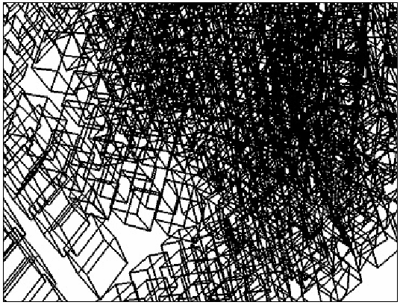
Introduction
Wireframe
  Simple, only edges of each object are drawn
  Can see through object
  It can be difficult to see what’s what

Slide 5
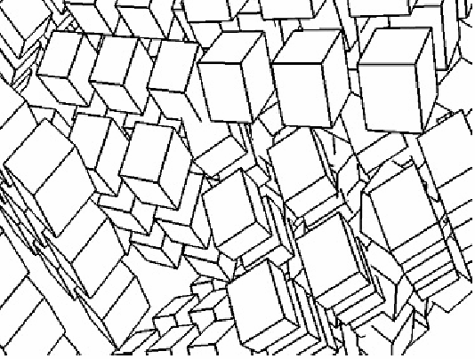
Introduction
Line Drawing: wire-frame with hidden surface removal
  Only edges are drawn
  The objects now look solid, and it is easy to tell where one stops and the next begins

Slide 6
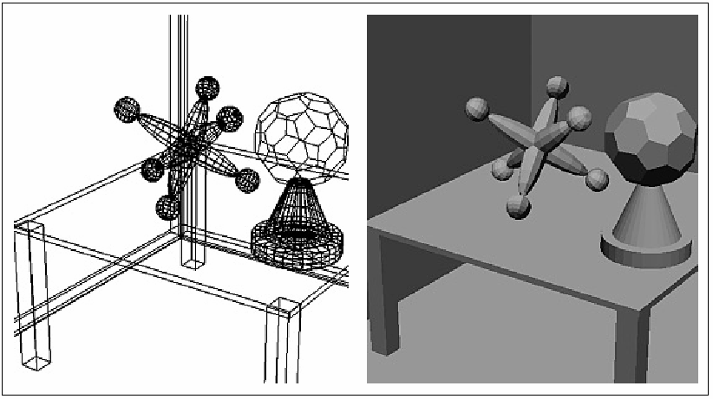
Introduction
Flat shading:
  A calculation of how much light is scattered from each face is computed at a single point.
  All points in a face are rendered with the same gray level
  Can see the Boundary between polygons

Slide 7
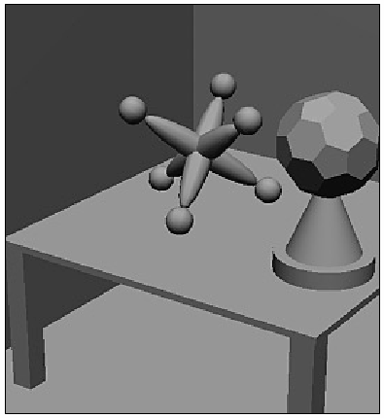
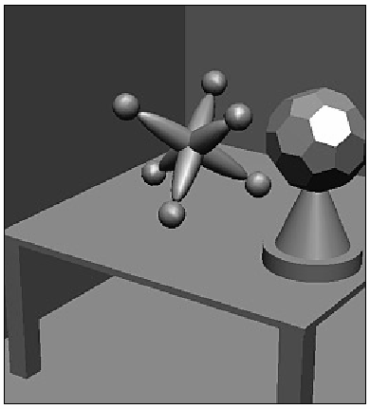
Introduction
Smooth shading (Gouraud shading):
  Different points of a face are drawn with different gray levels found through an interpolation scheme
  The edges of polygons disappear
specular

Slide 8
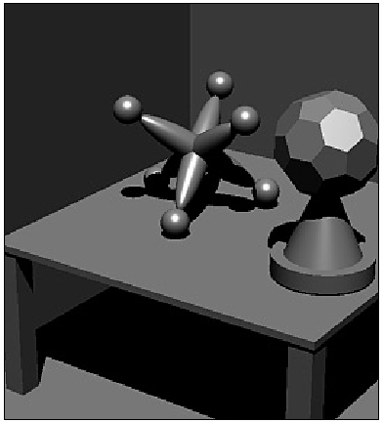
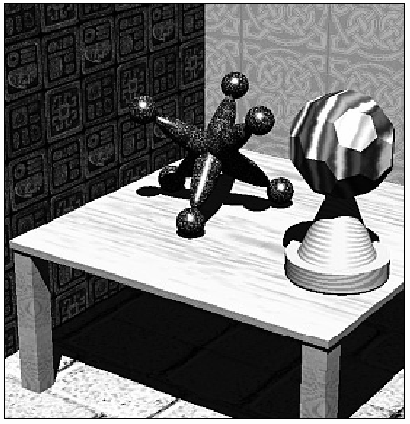
Introduction
Adding texture, shadow

Slide 9
Shading model
Light sources “shine” on the various surfaces of the objects, and the incident light interacts with the surface in three different ways:
  Some is absorbed by the surface and is convert to heat
  Some is reflected from the surface
  Some is transmitted into the interior of the objects, as in the case of a piece of glass.

Slide 10
Shading model
Two types of reflection of incident light:
  Diffuse: re-radiated uniformly in all directions. Interacts strongly with the surface, so it color is usually affected by the nature of material.
  Specular: highly directional, incident light doesnot penetrate the object, but instead is reflected directly from its outer surface. The reflected light has the same color as incident light.

Slide 11
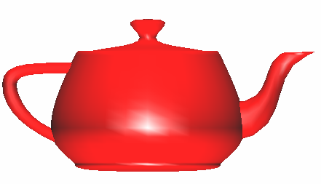
Shading model
Why does the image of a real teapot look like
Light-material interactions cause each point to have a different color or shade
To calculate color of the object, need to consider:
  Light sources
  Material properties
  Location of viewer
  Surface orientation

Slide 12
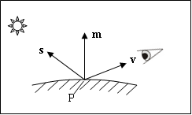
Shading model
Geometric ingredients for finding reflected light
  The normal vector m to the surface at P
  The vector v from P to the viewer’s eye
  The vector s from P to the light source

Slide 13
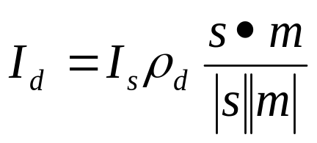
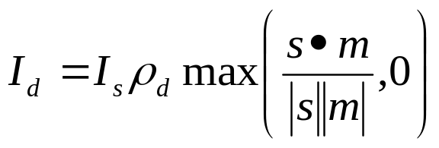
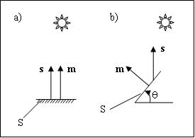
Shading model
Computing the Diffuse Component
  Diffuse component with an intensity denoted by I_{d}
  Scattering uniform in all directions → depend only on m, s
  Lambert’s law:
  I_{s}: intensity of light source, ρ_{d} : diffuse reflection coefficient

Slide 14
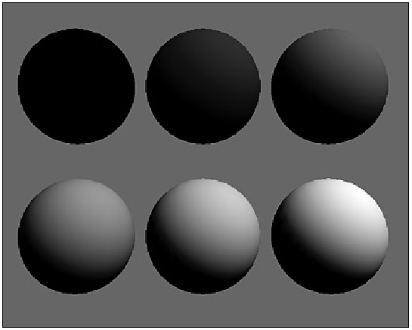
Shading model
Computing the Diffuse Component
  diffuse reflection coefficient : 0, 0.2, 0.4, 0.6, 0.8, 1.0

Slide 15
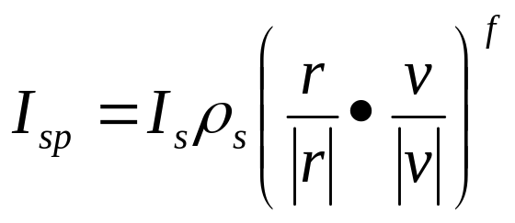
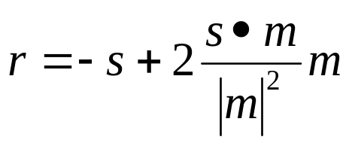
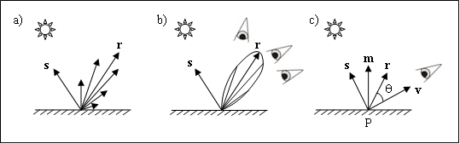
Shading model
Specular Reflection
  Specular reflection causes highlights, which can add significantly to the realism of a picture when objects are shiny
  The amount of light reflected is greated in the direction r.
f : [1, 200]

Slide 16
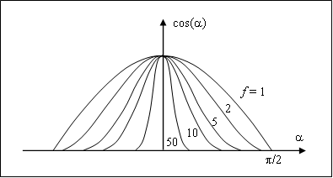
Shading model
Specular Reflection
  As f increase, the reflection becomes more mirror like and is more highly concentrated along the direction r.

Slide 17
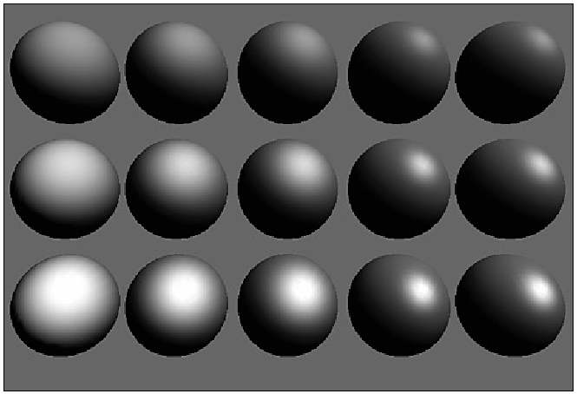
Shading model
Specular Reflection
  ρ_{s} from top to bottom: 0.25, 0.5, 0.75. f from left to right: 3, 6, 9, 25, 200

Slide 18
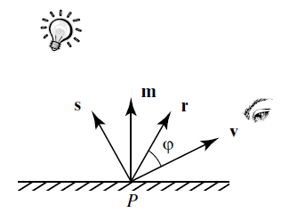
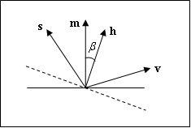
Shading model
Specular Reflection
  Reduce computation time, use halfway vector h = s + v.
  Use β as the approximation of angle between r and v

Slide 19
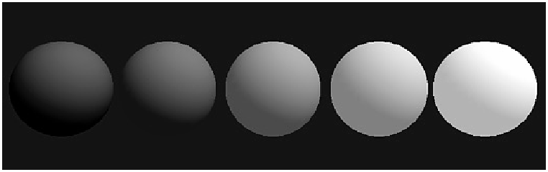
Shading model
Ambient Light
  To overcome the problem of totally dark shadows, we imagine that a uniform “background glow” called ambient light exist in the environment
  Not situated at any particular place, and spreads in all direction uniformly
  The source is assigned an intensity I_{a}. ρ_{a}: ambient reflection coefficient.

Slide 20
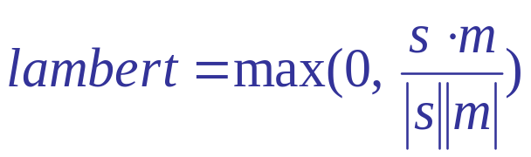
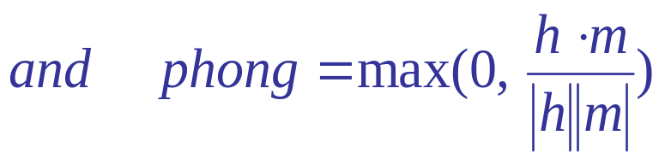
Shading model
Combining Light Contribution
Adding color

Slide 21
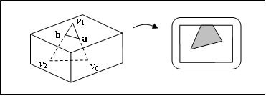
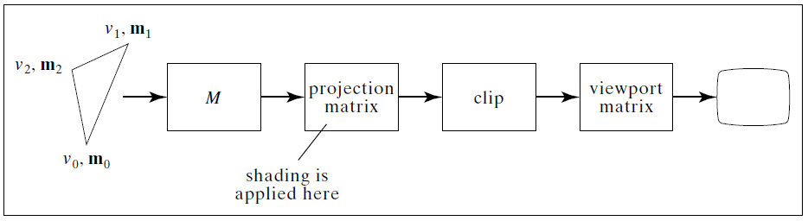
Shading model
Shading and the graphics pipeline
  Specify light source, camera, normal vector
glBegin(GL_POLYGON);
for(int i = 0; i< 3; i++){
glNormal3fv(norm[i]);
glVertex3fv(pt[i]);}
glEnd();

Slide 22
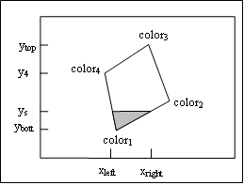
Flat shading & smooth shading
Painting a face
  The pixels in a polygon are visited in a regular order, usually scan line by scan line from bottom to top, and across each scan line from left to right
  Convex polygons can be made highly efficient, since, at each scan line, there is a single unbroken “run” of pixels.
for (int y = ybott ; y <= ytop ; y++) {
find xleft and xright;
for (int x = xleft; x <= xright; x++) {
find the color c for this pixel;
put c into the pixel at (x, y); } }

Slide 23
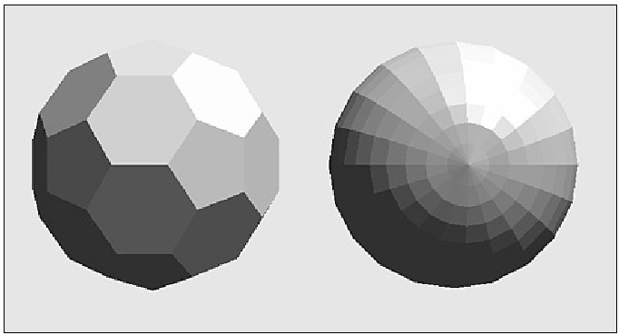
Flat shading & smooth shading
Flat shading
  Face is flat, light source are quite distant → diffuse light component varies little over different points
  glShadeModel(GL_FLAT);
for (int y = ybott ; y <= ytop ; y++) {
find xleft and xright;
find the color c for this scan line;
for (int x = xleft; x <= xright; x++) {
put c into the pixel at (x, y); } }

Slide 24
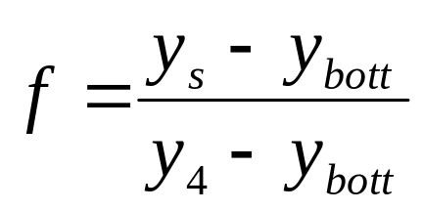
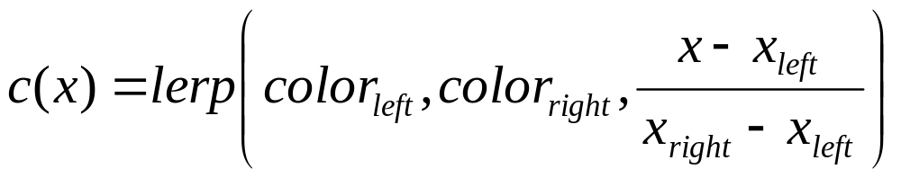
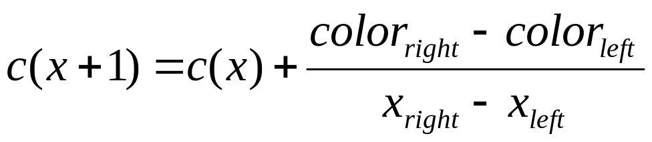
Flat shading & smooth shading
Smooth shading – Gouraud shading
  color_{left} = lerp(color₁, color₄, f),
for (int y = ybott ; y <= ytop ; y++){
find xleft and xright;
find colorleft and colorright;
colorinc = (colorright – colorleft)/ (xright – xleft)
for (int x = xleft, c = colorleft; x <= xright; x++, c += colorinc ) {
put c into the pixel at (x, y);}}

Slide 25
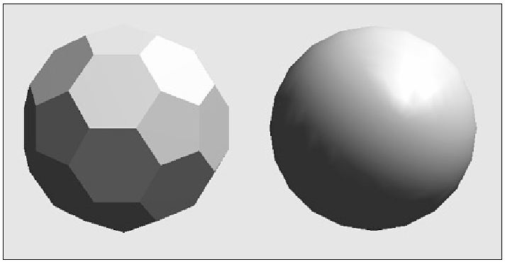
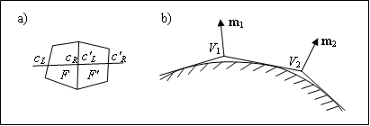
Flat shading & smooth shading
Smooth shading – Gouraud shading
  glShadeModel(GL_SMOOTH);

Slide 26
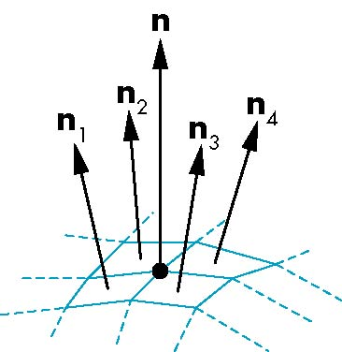
Flat shading & smooth shading
Smooth shading – Gouraud shading
  For polygonal models, Gouraud proposed we use the average of the normals around a mesh vertex
n = (n₁+n₂+n₃+n₄)/ |n₁+n₂+n₃+n₄|

Slide 27
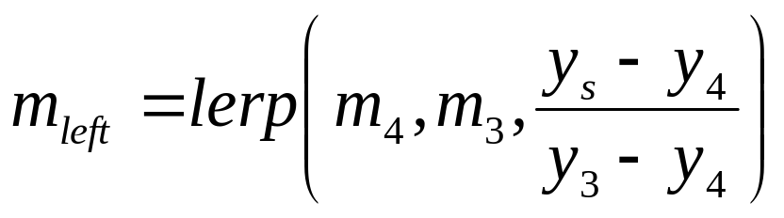
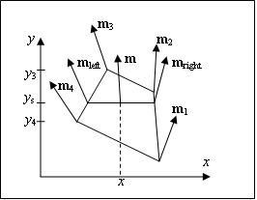
Flat shading & smooth shading
Smooth shading – Phong shading
  Slow calculation, better realism
  OpenGL doesn’t support

Slide 28
Steps in OpenGL shading
Specify normals
Enable shading and select model
Specify lights
Specify material properties

Slide 29
Specify normals
In OpenGL the normal vector is part of the state
Set by glNormal*()
  glNormal3f(x, y, z);
  glNormal3fv(p);
Usually we want to set the normal to have unit length so cosine calculations are correct
  glEnable(GL_NORMALIZE) allows for autonormalization at a performance penalty

Slide 30
Enabling Shading
Shading calculations are enabled by
  glEnable(GL_LIGHTING)
  Once lighting is enabled, glColor() ignored
Must enable each light source individually
  glEnable(GL_LIGHTi) i=0,1…..

Slide 31
Using Light Sources in OpenGL
Creating a light Source
  - Position
GLfloat myLightPosition[] = {3.0, 6.0, 5.0, 1.0};
glLightfv(GL_LIGHT0, GL_POSITION, myLightPosition);
(x, y, z, 1) →point light source, (x, y, z, 0)→directional light source
- Color
GLfloat amb0[] = {0.2, 0.4, 0.6, 1.0};
GLfloat diff0[] = {0.8, 0.9, 0.5, 1.0};
GLfloat spec0[] = {1.0, 0.8, 1.0, 1.0};
glLightfv(GL_LIGHT0, GL_AMBIENT, amb0);
glLightfv(GL_LIGHT0, GL_DIFFUSE, diff0);
glLightfv(GL_LIGHT0, GL_SPECULAR, spec0);

Slide 32
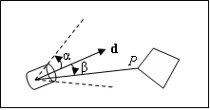
Using Light Sources in OpenGL
Splotlights
glLightf(GL_LIGHT0, GL_SPOT_CUTOFF, 45.0); // angle
glLightf(GL_LIGHT0, GL_SPOT_EXPONENT, 4.0); // ε = 4.0
GLfloat dir[] = {2.0, 1.0, -4.0}; // direction
glLightfv(GL_LIGHT0, GL_SPOT_DIRECTION, dir);

Slide 33
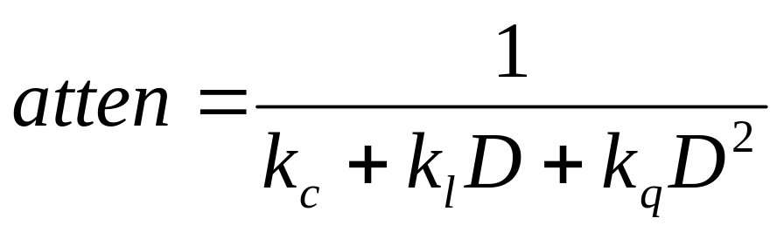
Using Light Sources in OpenGL
Attenuation of Light with distance
glLightf(GL_LIGHT0, GL_CONSTANT_ATTENUATION, 2.0);
GL_LINEAR_ATTENUATION and GL_QUADRATIC_ATTENUATION

Slide 34
Working with material in OpenGL
GLfloat myColor[] = {0.8, 0.2, 0.0, 1.0};
glMaterialfv(GL_FRONT, GL_DIFFUSE, myColor);
GL_BACK, GL_FRONT_AND_BACK
GL_AMBIENT, GL_SPECULAR,GL_EMISSION

Slide 35
Working with material in OpenGL
GLfloat ambient[] = {0.2, 0.2, 0.2, 1.0};
GLfloat diffuse[] = {1.0, 0.8, 0.0, 1.0};
GLfloat specular[] = {1.0, 1.0, 1.0, 1.0};
GLfloat shine = 100.0
glMaterialf(GL_FRONT, GL_AMBIENT, ambient);
glMaterialf(GL_FRONT, GL_DIFFUSE, diffuse);
glMaterialf(GL_FRONT, GL_SPECULAR, specular);
glMaterialf(GL_FRONT, GL_SHININESS, shine);

Slide 36
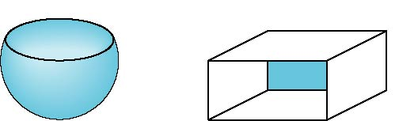
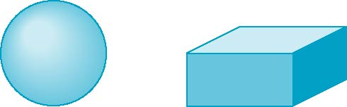
Front and Back Faces
The default is shade only front faces which works correctly for convex objects
If we set two sided lighting, OpenGL will shade both sides of a surface
Each side can have its own properties which are set by using GL_FRONT, GL_BACK, or GL_FRONT_AND_BACK
back faces not visible
back faces visible

Slide 37
Front and Back Faces
Specify Front Faces
  glFrontFace(GL_CCW), glFrontFace(GL_CW)
Cull Face
  glEnable(GL_CULL_FACE)
  glCullFace(GLenum mode);
    GL_FRONT,
    GL_BACK,
    GL_FRONT_AND_BACK

Slide 38
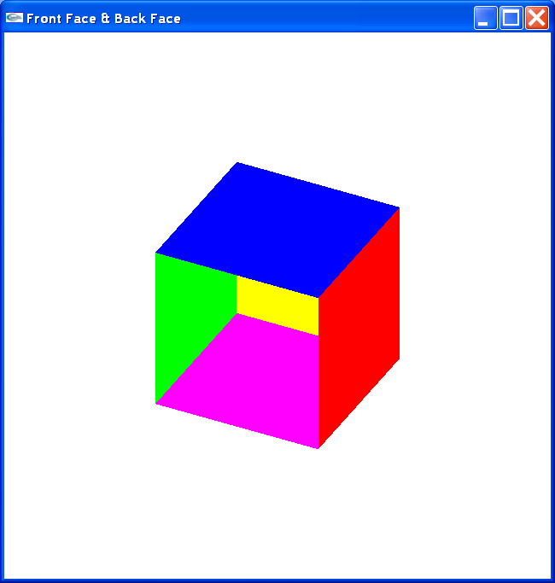
Front and Back Faces

Slide 39
Front and Back Faces
glBegin(GL_QUADS);
glColor3f(1, 0, 0); // x = 1
glVertex3f(1, 1, 1); glVertex3f(1, -1, 1);
glVertex3f(1, -1, -1); glVertex3f(1, 1, -1);
glColor3f(0, 1, 0); //x = -1
glVertex3f(-1, 1, 1); glVertex3f(-1, 1, -1);
glVertex3f(-1, -1, -1); glVertex3f(-1, -1, 1);
glColor3f(0, 0, 1); // y = 1
glVertex3f( 1, 1, 1); glVertex3f( 1, 1, -1);
glVertex3f(-1, 1, -1); glVertex3f(-1, 1, 1);
glColor3f(1, 0, 1); // y = -1
glVertex3f( 1, -1, 1); glVertex3f(-1, -1, 1);
glVertex3f(-1, -1, -1); glVertex3f( 1, -1, -1);
    ……………… // z = -1
glEnd();

Slide 40
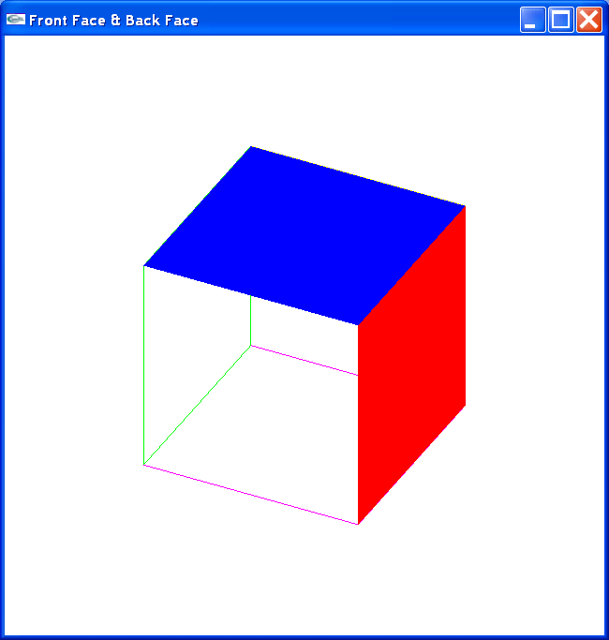
Front and Back Faces
glPolygonMode(GL_FRONT, GL_FILL);
glPolygonMode(GL_BACK, GL_LINE);

Slide 41
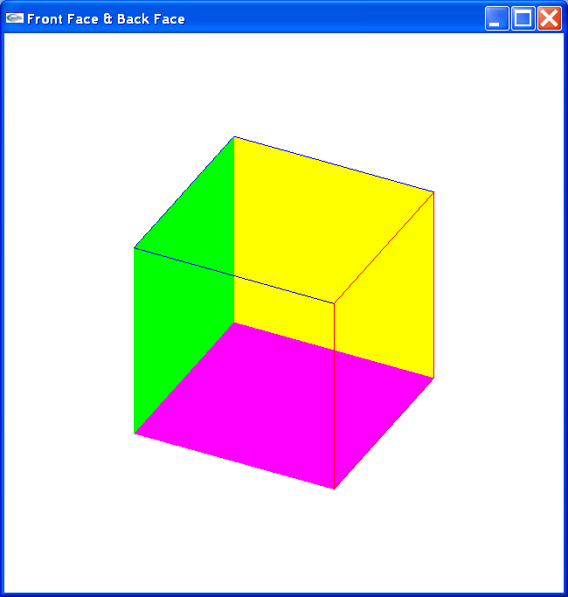
Front and Back Faces
glFrontFace(GL_CW);
glPolygonMode(GL_FRONT, GL_FILL);
glPolygonMode(GL_BACK, GL_LINE);

Slide 42
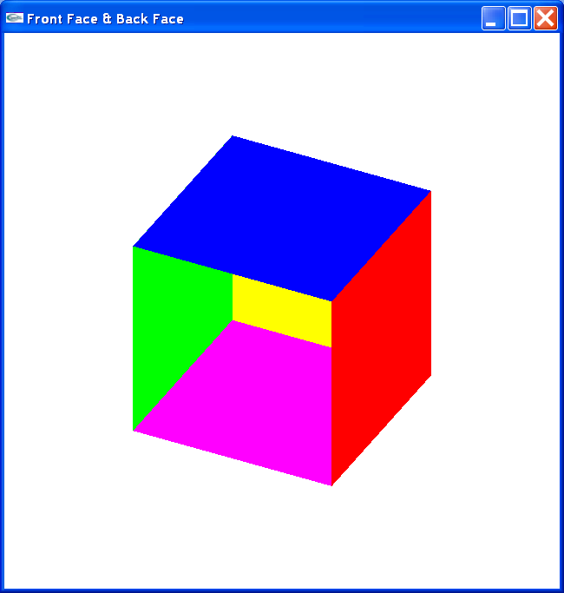
Front and Back Faces
glFrontFace(GL_CCW); //default
glPolygonMode(GL_FRONT, GL_FILL);
glPolygonMode(GL_BACK, GL_FILL);

Slide 43

Front and Back Faces
glFrontFace(GL_CCW);
glEnable(GL_CULL_FACE);
glCullFace(GL_BACK);

Slide 44
Computation of Vectors
s and v are specified by the application
Can compute r from s and m
Problem is determining m
For simple surfaces is can be determined but how we determine m differs depending on underlying representation of surface
OpenGL leaves determination of normal to application

Slide 45
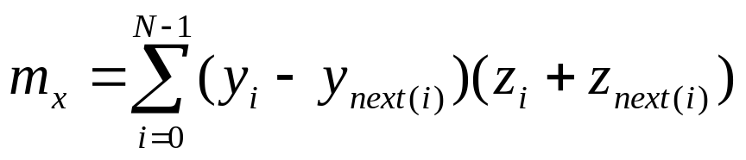
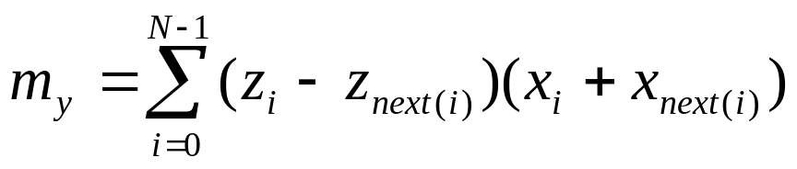

Computation of Vectors
If the face is flat → face’s normal vector is vertices normal vector
m = (V1 – V2) x (V3 – V4)
Two problem: 1) two vector nearly parallel, 2) not all the vertices lie in the same plane
- next(j) = (j + 1) mod N
- Traversed in CCW
- m outward

Slide 46
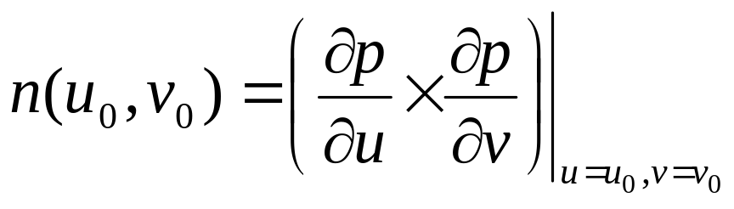
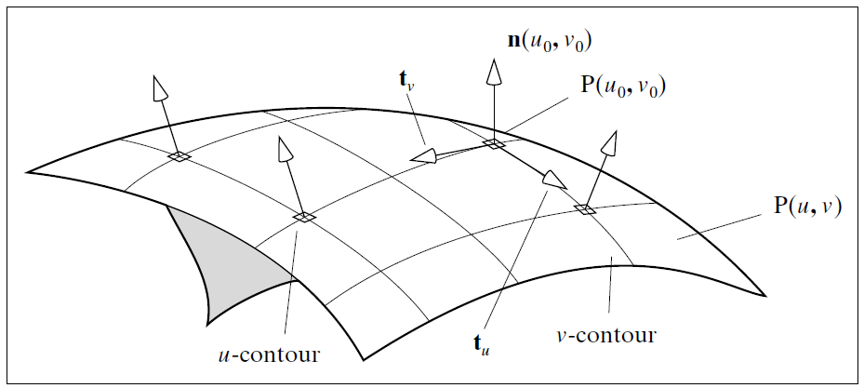
Computation of Vectors
Normal vector for a surface given parametrically

Slide 47
Computation of Vectors
Normal vector for a surface given parametrically
  EX: plane P(u, v) = C + au + bv
n(u, v) = a × b

Slide 48
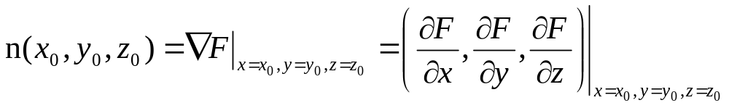
Computation of Vectors
Normal vector for a surface given implicitly
  EX: the implicit form of plane:
  F(x, y, z) = n • ((x, y, z) – A) = 0
  or: n_{x}x + n_{y}y + n_{z}z - n•A =0
  → normal is (n_{x}, n_{y}, n_{z})

Slide 49
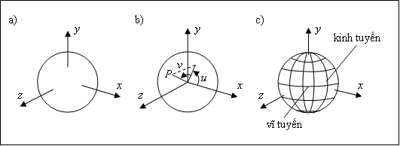
Generic Shapes
The sphere:
  Implicit form F(x, y, z) = x² + y² + z² – 1
  → normal (2x, 2y, 2z)
  Parametric form P(u, v) = (cos(v)cos(u), cos(v)sin(u), sin(v))
    →normal n(u, v) = -cos(u, v)p(u, v)

Slide 50

Generic Shapes
Cylinder:
  Implicit form F(x, y, z) = x² + y² – (1 + (s – 1)z)² 0< z<1 → n(x, y, z) = (x, y, -(s – 1)(1 + (s -1)z))
  Parametric form
  P(u, v) = ((1 + (s – 1)v)cos(u), (1 + (s – 1)v)sin(u), v)
  → n(u, v) = (cos(u), sin(u), 1-s)

Slide 51

Generic Shape
Cone
  - Implicit: F(x, y, z) = x² + y² – (1 – z)² = 0 0 < z < 1
  →n = (x, y, 1 – z)
  parametric P(u, v) = ((1 – v) cos(u), (1 – v)sin(u), v)
  →n(u, v) = (cos(u), sin(u), 1)

Slide 52
Further Reading
“Interactive Computer Graphics: A Topdown Approach Using OpenGL”, Edward Angel
  Chapter 6: Lighting and Shading
“Đồ họa máy tính trong không gian ba chiều”, Trần Giang Sơn
  Chương 3: Tô màu vật thể ba chiều (3.1 → 3.4)

